Slide 1
Will Hopkins William.Hopkins@vu.edu.au, WillTheKiwi@gmail.com, sportsci.org/will
Victoria University, Melbourne, Australia
Important Effect Sizes for Exercise and Sport Practitioners and Scientists
Differences and changes in means
  Standardization: Cohen's d thresholds modified and augmented
  Visual analog and Likert scales: proportion of "full-scale deflection"
  Competitive performance: match and medal winning and losing
Correlations
  Population: Cohen's thresholds augmented
  Reliability and validity: higher thresholds via evaluating SDs
Slopes or gradients
  Evaluation of 2 SD of predictor and implications for Cohen's d
Effects with proportions
  Differences; ratios; hazard ratios; odds ratios
Count ratios

Slide 2
Introduction
Practitioners need to know about important magnitudes to monitor athletes or patients.
Researchers need the smallest important magnitude of an effect statistic to estimate sample size for a study.
  If the true effect is (un)important, the study should have a reasonable chance of showing that the effect is (un)important.
Practitioners and researchers need to know about important magnitudes to interpret research findings.
The most important magnitude is the smallest important.
  There are two equal and opposite smallest importants: beneficial and harmful, or positive and negative, or increase and decrease.
  Any magnitude between the smallest importants is trivial.
  Otherwise it is small, moderate, large, very large, or huge.
    Jacob Cohen was the pioneer of magnitudes, but he stopped at large.
    And he made mistakes with his "d", as we will see!
This slideshow identifies these magnitudes for various effects.

Slide 3
Differences or Changes in the Mean
This is the most common effect statistic for
numbers with decimals (continuous variables).
Difference when comparing
different groups, e.g., patients vs healthy.
Change when tracking the same subjects.
Difference in the changes in controlled trials.
Standardization for Effects on Means
The between-subject standard deviation
provides default thresholds for important
differences and changes.
  You think about the effect (Δmean) in terms of a
  fraction or multiple of the SD: Δmean/SD.
  The effect is said to be standardized.
  Δmean/SD is Cohen's d.
Strength
patients
healthy
Data are means & SD.
Strength
pre
post1
post2
Trial
Data are means & SD.

Slide 4
Example: the effect of a treatment on strength
Trivial effect (0.10x SD)
Very large effect (3.0x SD)
post
post
pre
pre
strength
strength
Interpretation of
standardized
difference or
change in means:
Cohen
Hopkins
trivial
<0.20
<0.20
small
0.20-0.50
0.20-0.60
moderate
0.50-0.80
0.60-1.2
large
>0.80
1.2-2.0
very large
?
2.0-4.0
huge (extremely large)
?
>4.0
trivial
±0.20
small
±0.60
moderate
±1.2
large
±2.0
very large
±4.0
huge

Slide 5
Some important points about standardization
  Standardizing works only when the SD comes from a sample that is representative of a well-defined population.
    The resulting magnitude applies only to that population.
  Choice of the SD can make a big difference to the effect.
    To compare two group means, use SD of the "reference" group.
    Or to average the standardized effects, use the harmonic mean SD:
    1/SD_{H} = (1/SD_{A} + 1/SD_{B})/2 for two groups, A and B.
    In a controlled trial, use the baseline (pre-test) SD of all subjects.
  Standardized effects need adjustment for bias in small samples.
    Sample SDs are biased low, hence Δmean/SD is biased high.
  Beware of authors who show standard errors of the mean ("SEM").
    SEM = SD/√(sample size). So effects look bigger than they really are.
    The SEM should be banned.
  But avoid standardization! Use only when your measure has no known relationship to health, wealth or competitive performance.
Other options for effects with means of some special variables:
visual-analog scales, Likert scales, athletic performance…

Slide 6
Visual-analog scales (VAS)
The respondents indicate a perception on a line like this:
  Rate your pain by placing a mark on this scale:
  Score the response as percent of the length of the line.
  A change of <10% (e.g., 68%→61%) might be imperceptible.
    So <10% is trivial.
  A change of >90% (e.g., 4%→97%) would be huge.
  Hence thresholds for proportion of "full-scale deflection" or range:
  Use this scale also to grade the intensity of the perception?
    Replace small with low, and large with high.
When responses include, or come close to, 0 or 100, a VAS may need to be analyzed as the proportion via over-dispersed logistic regression.
none
✗
unbearable
trivial
±10%
small
±30%
moderate
±50%
large
±70%
very large
±90%
huge

Slide 7
Likert scales
Example: How easy or hard was the training session today?
  very easy easy moderate hard very hard
  Code as integers (1, 2, 3, 4, 5…), rescale to range from 0-100,
  then use the same thresholds as for visual-analog scales,
  Or use equivalent thresholds with the integer scale. Example:
    A 5-pt scale is coded 1 to 5. The range is 5 – 1 = 4 (steps).
    Hence thresholds: 10% of 4 = 0.4; 30% of 4 = 1.2, etc.
Dimensions in a psychometric inventory consist of sums or averages of multiple Likert scales, all coded as integers.
  Example: several dimensions of motivation.
  Each dimension should be rescaled to range from a minimum possible score of 0 and a maximum possible score of 100.
  The magnitude thresholds could then be the same as for visual analog scales (±10%, ±30%, etc.).
  But standardization probably provides more realistic thresholds.
Analysis may require over-dispersed logistic regression.
✓

Slide 8
Measures of Athletic Performance
Fitness tests and performance indicators of team-sport athletes:
  Until you know how changes in tests or indicators of individual athletes affect chances of winning, standardize the scores with the SD of players in each on-field position.
Performance in matches or competitions between top athletes is all about winning or medals.
  Extra/fewer wins or medals for every 10 matches or events:
  For matches, analyze wins and losses with logistic regression.
  For competitions, there usually aren't enough data to analyze medal-winning directly.
    Researchers use time trials or fitness tests similar to competitions.
    What improvements in time trials or tests result in extra medals?
    The within-athlete variability that athletes show from competition to competition determines the improvements. For example…
trivial
±1.0
small
±3.0
moderate
±5.0
large
±7.0
very large
±9.0
huge

Slide 9
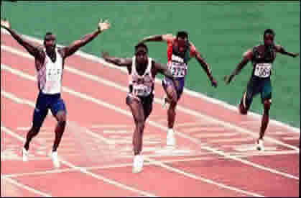
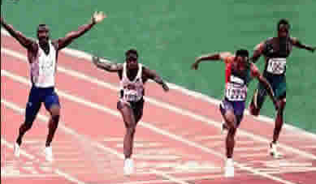
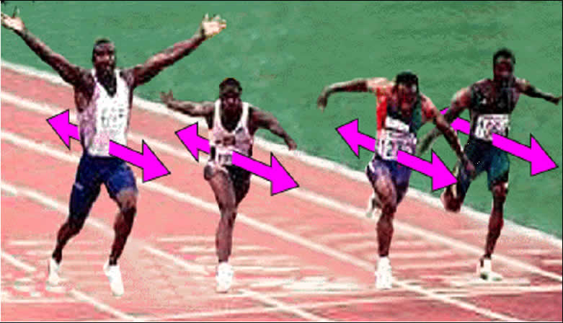
    Your athlete needs an enhancement that overcomes this variability to get a bigger chance of a medal.
    Simulations show that an enhancement of 0.3× the variability gives one extra medal every 10 competitions.
    (In some early publications I mistakenly stated ~0.5× the variability!)
    Example: if the variability is an SD (or CV) of 1%, the smallest important enhancement is 0.3%.
    Similarly, 0.9×, 1.6×, 2.5× and 4.0× the variability give 3, 5, 7 and 9 extra medals every 10 competitions.
    Hence this scale for important changes as factors of the variability:
    For SD>~5%, apply these factors to 100*ln(1+SD/100).
Race 1
Race 2
Race 3
trivial
±0.30x
small
±0.90x
moderate
±1.6x
large
±2.5x
very large
±4.0x
huge

Slide 10
Beware: smallest effects on athletic performance in performance tests depend on the method of measurement, because…
  A percent change in an athlete's ability to output power results in different percent changes in performance in different tests.
  These differences are due to the power-duration relationship for performance and the power-speed relationship for different modes of exercise.
  Example: a 1% change in endurance power output produces the following changes…
    1% in running time-trial speed or time;
    ~0.4% in road-cycling time-trial time;
    0.3% in rowing-ergometer time-trial time;
    ~15% in time to exhaustion in a constant-power test.
    A hard-to-interpret change in any test following a fatiguing pre-load. (But such tests can be interpreted for cycling road races: see Bonetti and Hopkins, Sportscience 14, 63-70, 2010.)
See Assessing athletes at Sportscience for more.

Slide 11
Correlation Coefficient
This represents the overall linearity in a scatterplot. Examples:
Negative correlations represent negative slopes.
The correlation is unaffected by the scaling of the two variables.
Cohen opted for ±0.10, ±0.30 and ±0.50 for low, moderate and high population correlations. I added two more thresholds:
  >0.90 is also "almost perfect".
Correlations for reliability and validity have higher thresholds.
  These thresholds can be calculated by considering the magnitude of the standard deviation (SD) representing the error when assessing an individual…
r = 0.00
r = 0.10
r = 0.30
r = 0.50
r = 0.70
r = 0.90
r = 1.00
trivial
±0.10
low
±0.30
moderate
±0.50
high
±0.70
very high
±0.90
huge

Slide 12
  An SD represents the difference between two measurements, similar to the difference between two means.
  The magnitude of an SD has to be assessed by doubling it, or equivalently, by halving the thresholds for comparing means.
  Hence the following magnitude thresholds via standardization for a reliability correlation (test-retest or ICC):
  And for a validity correlation of a practical with an error-free criterion:
    Thresholds for validity r = √(reliability r).
  See Validity and reliability at Sportscience for more.
Slope (or Gradient)
A correlation is easy to evaluate, but a slope is more practical.
As with the correlation coefficient, use it when a straight line looks like the best way to fit a trend in a scatterplot…
impractical
±0.20
v. poor
±0.50
poor
±0.75
good
±0.90
v. good
±0.99
excellent
impractical
±0.45
v. poor
±0.70
poor
±0.85
good
±0.95
v. good
±0.995
excellent

Slide 13
A slope is also known as a "beta": the difference
in the dependent per unit of the predictor.
But the unit of the predictor is arbitrary.
  Example: a 2% per year decline in activity
  seems trivial,
So evaluate a slope as the difference in the
dependent per two SDs of predictor. Why?
  A slope represents a comparison of two means.
  2 SD gives the difference in the dependent variable between a typically low and typically high subject.
  If you compare the means via standardization, the SD for standardizing is the standard error of the estimate (SEE).
    The SEE is the scatter about the line (the same all along the line).
  2 SD makes a small Cohen's d (0.20) = a small correlation (0.10).
  But 2 SD makes correlations of 0.30, 0.50, 0.70 and 0.90 correspond to Cohen's d of 0.63, 1.15, 2.0 and 4.1.
  Hence my revised and augmented thresholds for Cohen's d.
Physical activity
yet 20% per decade seems large.
2 SD
Age

Slide 14
Differences and Ratios of Proportions, Risks, Odds, Hazards
Example: the effect of sex (female, male) on risk of injury in football.
  Express the injuries as a proportion
  of all players.
Risk difference or proportion difference
  A common measure.
  Example: a - b = 75% - 36% = 39%.
  Problem: the proportion difference is no good for time-dependent proportions (e.g., injuries).
    For very short monitoring periods the proportions in both groups are ~0%, so the proportion difference is ~0%.
    Similarly for very long monitoring periods, the proportions in both groups are ~100%, so the proportion difference is ~0%.
100
Proportion
injured
(%)
a =
75%
b =
36%
0
male
female
Sex

Slide 15
  Another problem: the sense of magnitude of a given difference depends on how big the proportions are.
    Example: for a 10% difference, 90% vs 80% doesn’t seem big, but…
    11% vs 1% can be interpreted as a huge "difference" (11x the risk).
  So there is no scale of magnitudes for a risk or proportion difference.
  Exception #1: time-independent proportions, where <10% is trivial and >90% is almost everyone (e.g., proportion choosing an item).
    High proportions are possible, so the focus is on everyone (the denominator), not just the small proportion of cases (the numerator).
    Use this scale for such proportions and their differences:
  Exception #2: winning and losing close matches.
    One extra match in every 10 close matches is a proportion difference of 10% (55% – 45%); 3 extra is 30% (65% – 35%), etc.
    Hence use the above scale, representing 1, 3, 5, 7 and 9 wins and losses in every 10 matches.
  Analyze these proportion differences via a special transformation.
trivial
±10%
small
±30%
moderate
±50%
large
±70%
very large
±90%
huge

Slide 16
Risk ratio (relative risk) or proportion ratio
  Another common measure.
  Example: a/b = 75/36 = 2.1, which means
  males are "2.1 times more likely" to be injured,
  or "a 110% increase in risk" of injury for males.
  Problem: if it's a time-dependent measure, and you
  wait long enough, everyone gets affected, so risk ratio = 1.00.
  But it works for rare time-dependent risks and for small time-independent proportions (e.g., proportion selected for Olympics).
  Magnitude thresholds? Small, moderate, large, very large and extremely large risk ratios occur when, for every 10 males injured, the number of females injured is 9, 7, 5, 3 or 1.
    So the ratios are 10/9, 10/7, 10/5, 10/3 and 10/1, and their inverses.
  Hence this complete scale for low-risk ratios and proportion ratios:
    Analysis via special transformations.
100
Proportion
injured
(%)
a =
75%
b =
36%
0
male
female
Sex
trivial
1.11
0.90
small
1.43
0.70
moderate
2.0
0.50
large
3.3
0.30
very large
10
0.10
huge

Slide 17
Hazard ratio for time-dependent events.
  To understand hazards, consider
  the increase in proportions with time.
  Over a very short period, the risk in both groups
  is tiny, and the risk ratio is independent of time.
  Example:
  risk for males = a = 0.28% per 1 d = 0.56% per 2 d,
  risk for females = b = 0.11% per 1 d = 0.22% per 2d.
  So risk ratio = a/b = 0.28/0.11 = 0.56/0.22 = 2.5.
    That is, males are 2.5x more likely to get injured
    per unit time, whatever the (small) unit of time.
  The risk per unit time is called a hazard or incidence rate.
  Hence hazard ratio, incidence-rate ratio or “right-now” risk ratio.
  Magnitude thresholds are the same as for the proportion ratio:
  Analyze via cumulative log-log transformation in generalized linear model.
100
males
Proportion
injured (%)
females
0
Time (months)
a
b
trivial
1.11
0.90
small
1.43
0.70
moderate
2.0
0.50
large
3.3
0.30
very large
10
0.10
huge

Slide 18
Odds ratio for time-independent proportions or classifications.
  Odds are the awkward but the only proper way to analyze classifications and percents of full scale deflection.
  Example: proportion of males and females playing a school sport.
    Odds of a male playing = a/c = 75/25.
    Odds of a female playing = b/d = 36/64.
    Odds ratio = (75/25)/(36/64) = 5.3.
  The odds ratio can be interpreted as
  "…times more likely" only when the proportions
  in both groups are small (<10%).
    The odds ratio is then approximately equal to the proportion ratio.
  Analyze via the log-odds (logistic) transformation in a generalized linear model.
  When one or both proportions are >10%, you must convert the odds ratio and its confidence limits into a proportion difference or proportion ratio to interpret the magnitude.
100
c =
25%
Proportion
playing
(%)
d =
64%
a =
75%
b =
36%
0
male
female
Sex

Slide 19
Ratio of Counts
Example: 93 vs 69 injuries per 1000 player-hours of match play in sport A vs sport B.
  The effect is expressed as a ratio: 93/69 = 1.35x more injuries.
  It can also be expressed as 35% more injuries.
The scale of magnitudes is the same as for ratio of proportions:
  Analyze via log transformation in a generalized linear model.
Final Thoughts
The thresholds all derive from 1, 3, 5, 7 and 9 in 10 things.
Maybe the smallest should be 1 in 20 (and the largest 19 in 20).
  But sample sizes would need to be 4x larger, which would usually be impractical. So let's stay with 1 in 10.
I suspect the 3 and 7 should be either 2.5 and 7.5, or 3.5 and 6.5.
  I'll try to decide before I retire or die.
1.11
0.90
1.43
0.70
2.0
0.50
3.3
0.30
10
0.10
trivial
small
moderate
large
very large
huge

Slide 20


Where to find a link to this presentation:

